Slide 1
MD Assistant
Creators: Jason Yeh & Taylor Turner
Development Team: Leo Rofe, Gideon Rosenthal & Tony Yan

Slide 2
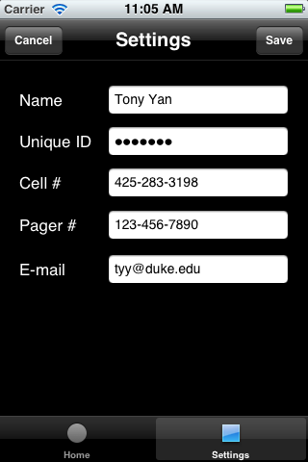
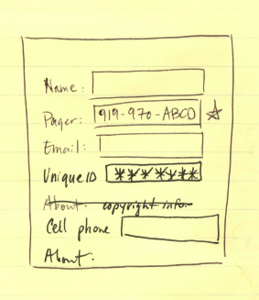
Sign In

Slide 3
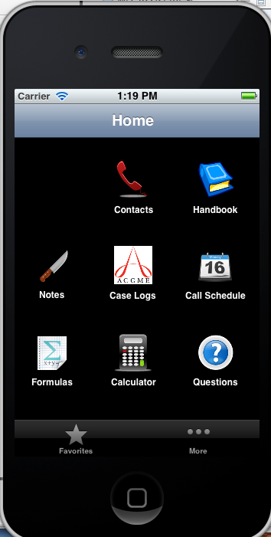
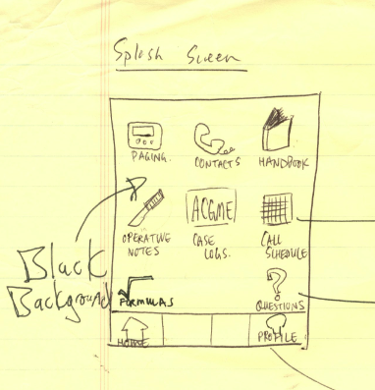
Title Page

Slide 4
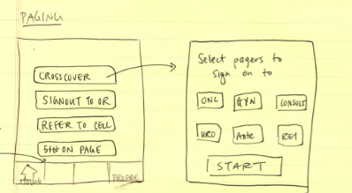
Paging

